Slide 1
Recommending happiness
A guide by students of IDMC Shalini Priya, Claésia Costa, Soklay Heng, Peter Pribil,Colleen

Slide 2
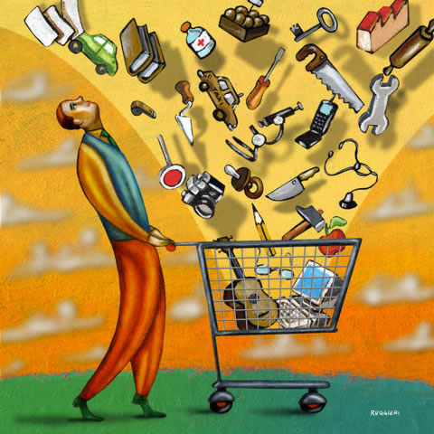
Appeal to consumer society
Recommender systems transform humans into easily predictable time series.
The more you know about them, the happier you make them!

Slide 3


1. Recipe for a great system
Behavioral data Customer activity before purchase
Right mindset What to base recommendations on
Model An algorithm that goes well with our data

Slide 4
Your data
Product categories
Products
Clicks
Item views
Purchases
Queries

Slide 5
2. Models
LESSR
Item Based Collaborative Filtering.

Slide 6

LESSR
GNN
Easy to implement
Session-based recommendation
Calculated measures:
HR
MRR
NDCG:

Slide 7
The data
"sessionId" - The ID of the session, ascending order
"items" - A list of items in the given session

Slide 8
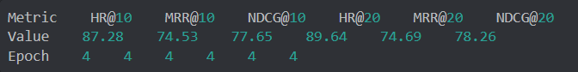
Result

Slide 9
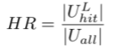
Hit Ratio
« L=20 »
[pear, orange, apple, banana]
[pear, orange, apple, kiwi]

Slide 10
Mean Reciprocal Rank
« L=20 »
[cabbage, apple, pear, orange]
[pear, orange, apple, cabbage]

Slide 11
HR
DMRR
1
HR
MRR
2
HR
MRR
3
HR
MRR

Slide 12
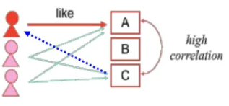
Item Based Collaborative Filtering
Use user-item matrix
Make item-item correlations
Find items that are highly correlated
Recommend items with highest correlations
Note:
Cosine similarity was calculated

Slide 13
Input
"userId" - The ID of the user
"items" - A list of items in the given session

Slide 14
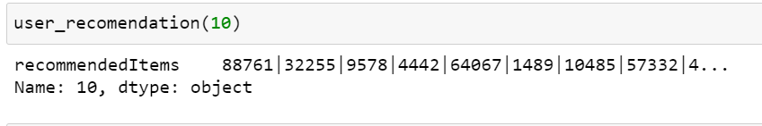
Result
Recommendation for the userId-10

Slide 15
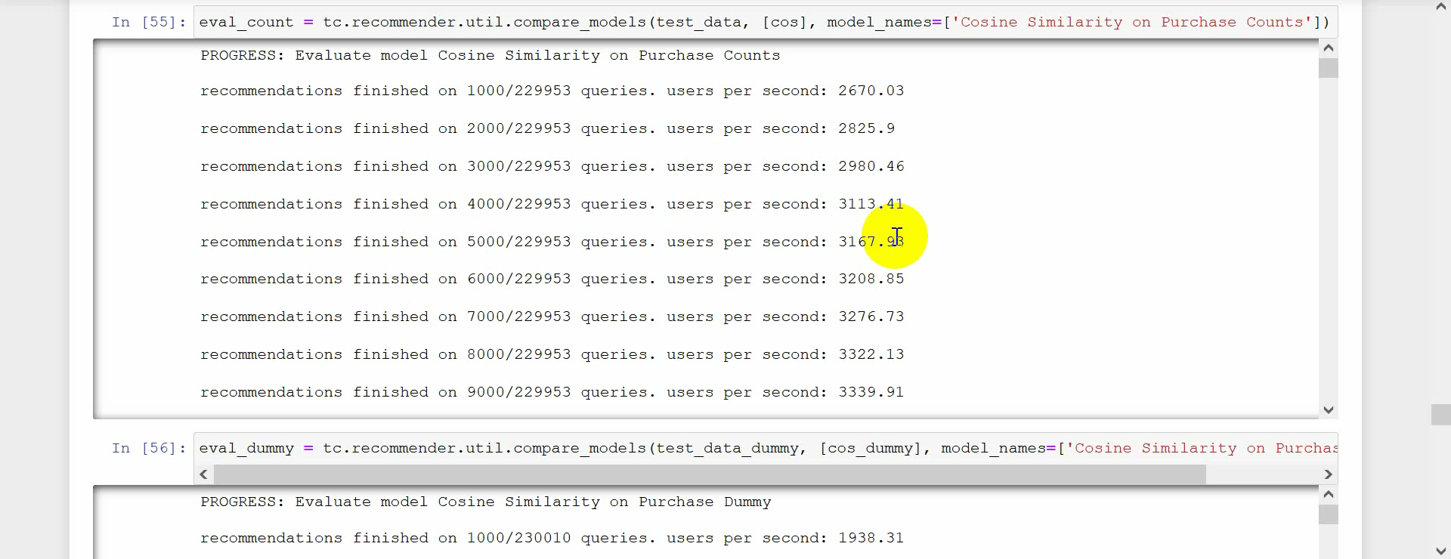

Slide 16
Benefits:
Create customer satisfaction
Reduce time and effort
Boost number of items per order
Increase revenues

Slide 17
Contact us!
m2group1@idmc.com

